Slide 1
SQL – DATA DEFINITION AND DATA MANIPULATION (1)
Course : ISYS6280 – Database Systems (GAT)
Year : 2017
Session 5&6

Slide 2
LEARNING OUTCOME
LO 2 : Apply database language and SQL Programming language

Slide 3
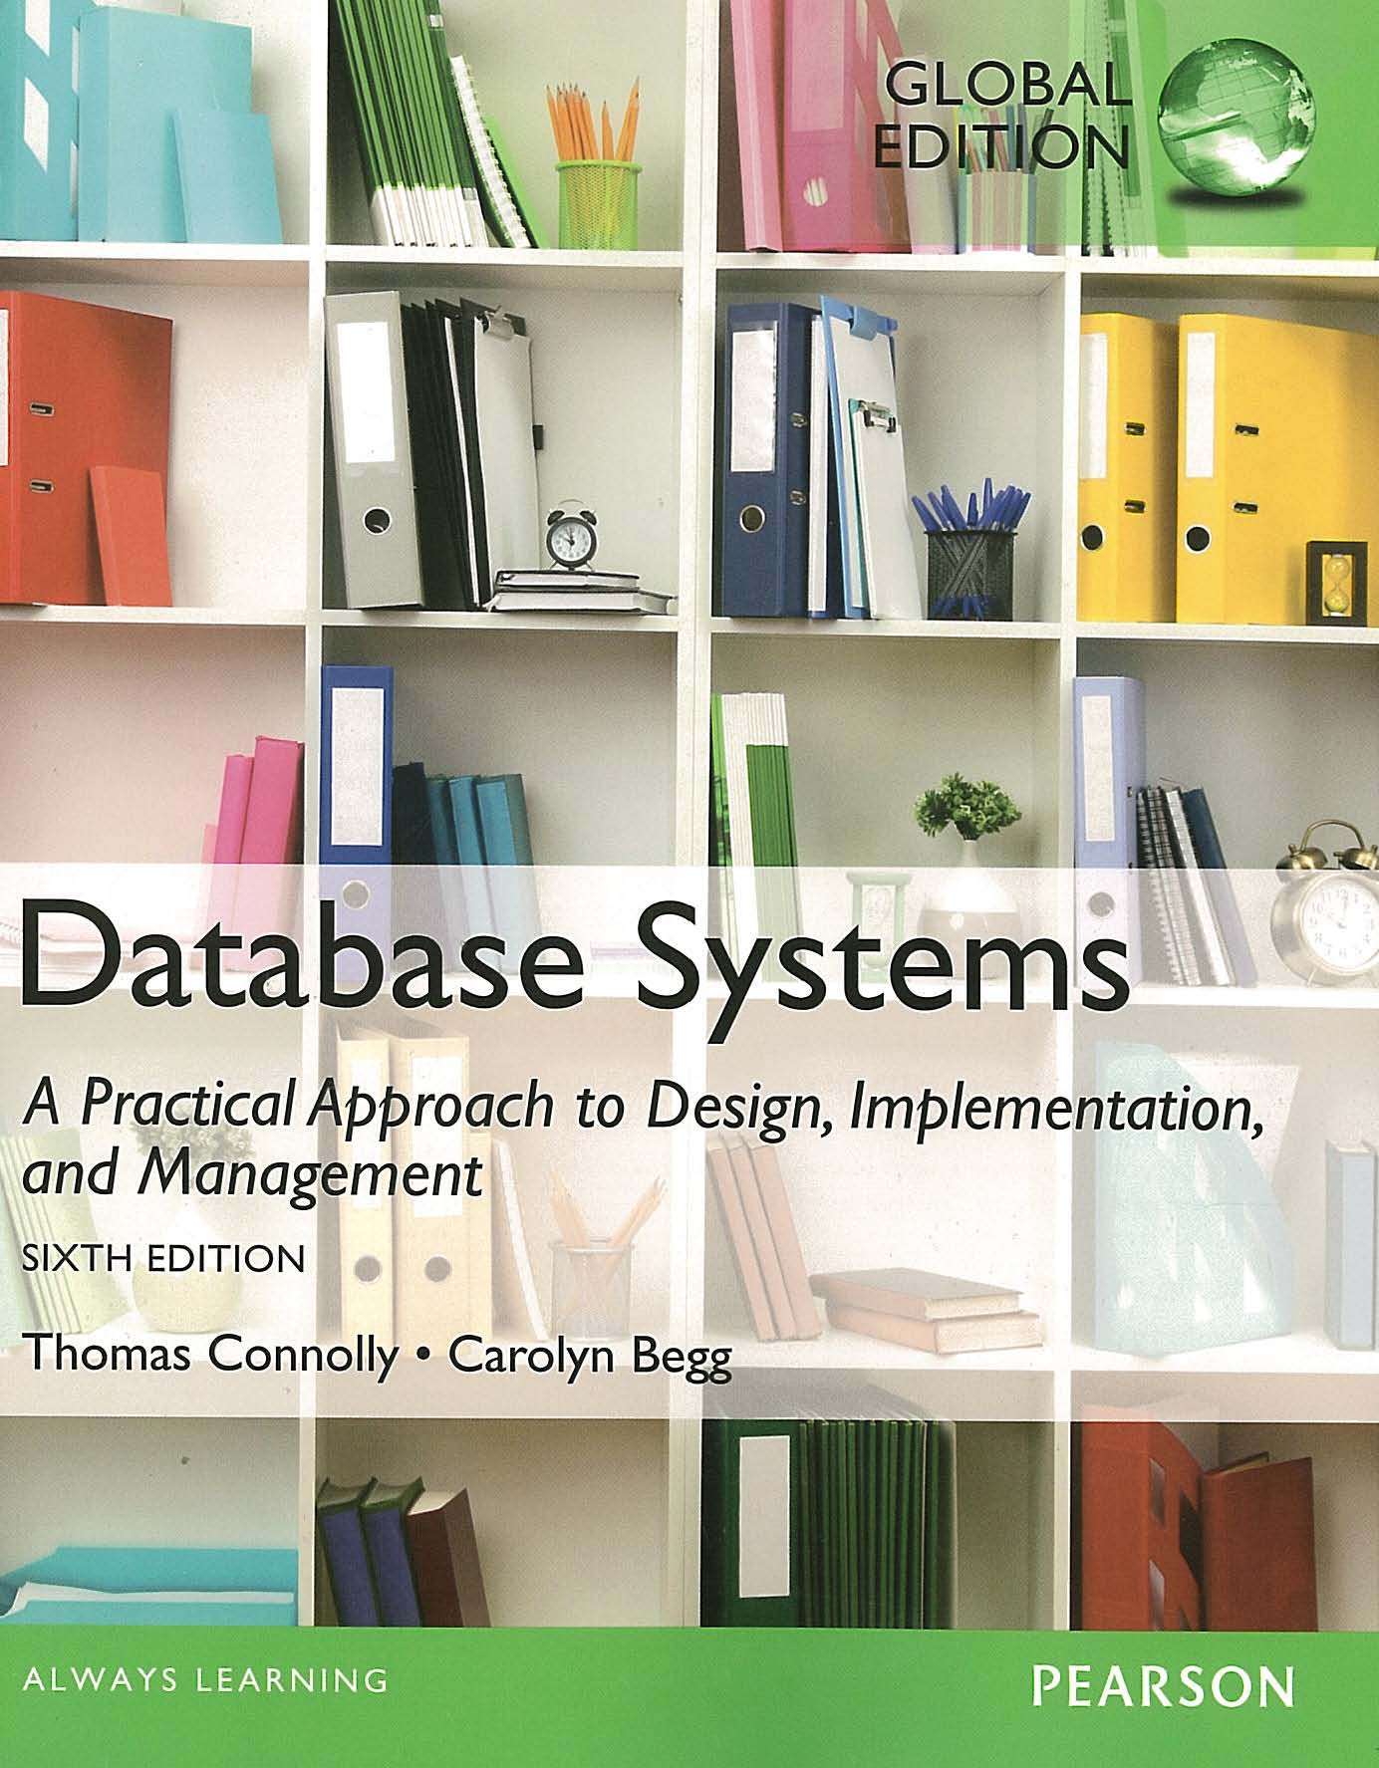
ACKNOWLEDGEMENT
These slides have been adapted from Thomas Connolly and Carolyn Begg. 2015. Database Systems: A Practical Approach To Design, Implementation, and Management. Pearson Education. USA. ISBN:978-1-292-06118-4

Slide 4
CHAPTER 7 SQL : DATA DEFINITION

Slide 5

LEARNING OBJECTIVES-CHAPTER 7
Purpose and importance of SQL
Data types supported by SQL standard.
Purpose of integrity enhancement feature of SQL.
How to define integrity constraints using SQL.
How to use the integrity enhancement feature in the CREATE and ALTER TABLE statements.
How to use the GRANT and REVOKE statements as a level of security.
vtraining-msuhandi.blogspot.com

Slide 6
Objectives of SQL
Ideally, database language should allow user to:
create the database and relation structures;
perform insertion, modification, deletion of data from relations;
perform simple and complex queries.
Must perform these tasks with minimal user effort and command structure/syntax must be easy to learn.
It must be portable.
SQL is a transform-oriented language with 2 major components:
A DDL for defining database structure.
A DML for retrieving and updating data.

Slide 7
Objectives of SQL
Until SQL:1999, SQL did not contain flow of control commands. These had to be implemented using a programming or job-control language, or interactively by the decisions of user.
SQL is relatively easy to learn:
it is non-procedural - you specify what information you require, rather than how to get it;
it is essentially free-format.
Can be used by range of users including DBAs, management, application developers, and other types of end users.
An ISO standard now exists for SQL, making it both the formal and de facto standard language for relational databases.

Slide 8
Objectives of SQL
Consists of standard English words:
1) CREATE TABLE Staff(staffNo VARCHAR(5),
lName VARCHAR(15),
salary DECIMAL(7,2));
2) INSERT INTO Staff VALUES (‘SG16’, ‘Brown’, 8300);
3) SELECT staffNo, lName, salary
FROM Staff
WHERE salary > 10000;

Slide 9

History of SQL
In 1974, D. Chamberlin (IBM San Jose Laboratory) defined language called ‘Structured English Query Language’ (SEQUEL).
A revised version, SEQUEL/2, was defined in 1976 but name was subsequently changed to SQL for legal reasons.
Still pronounced ‘see-quel’, though official pronunciation is ‘S-Q-L’.
IBM subsequently produced a prototype DBMS called System R, based on SEQUEL/2.
Roots of SQL, however, are in SQUARE (Specifying Queries as Relational Expressions), which predates System R project.
historyarthistory.gmu.edu

Slide 10

History of SQL
In late 70s, ORACLE appeared and was probably first commercial RDBMS based on SQL.
In 1987, ANSI and ISO published an initial standard for SQL.
In 1989, ISO published an addendum that defined an ‘Integrity Enhancement Feature’.
In 1992, first major revision to ISO standard occurred, referred to as SQL2 or SQL/92.
In 1999, SQL:1999 was released with support for object-oriented data management.
In late 2003, SQL:2003 was released.
In summer 2008, SQL:2008 was released.
In late 2011, SQL:2011 was released.
kiossoftware.com

Slide 11
Importance of SQL
SQL has become part of application architectures such as IBM’s Systems Application Architecture.
It is strategic choice of many large and influential organizations (e.g. X/OPEN).
SQL is Federal Information Processing Standard (FIPS) to which conformance is required for all sales of databases to American Government.
SQL is used in other standards and even influences development of other standards as a definitional tool. Examples include:
ISO’s Information Resource Directory System (IRDS) Standard
Remote Data Access (RDA) Standard.

Slide 12
Writing SQL Commands
SQL statement consists of reserved words and user-defined words.
Reserved words are a fixed part of SQL and must be spelt exactly as required and cannot be split across lines.
User-defined words are made up by user and represent names of various database objects such as relations, columns, views.
Most components of an SQL statement are case insensitive, except for literal character data (for example: lastName 'SMITH' is different from 'Smith').
More readable with indentation and lineation:
Each clause should begin on a new line.
Start of a clause should line up with start of other clauses.
If clause has several parts, should each appear on a separate line and be indented under start of clause to show the relationship.

Slide 13
Writing SQL Commands
Use extended form of BNF notation:
- Upper-case letters represent reserved words.
- Lower-case letters represent user-defined words.
- A vertical bar ( | ) indicates a choice among alternatives; for example: a | b | c.
- Curly braces indicate a required element; for example: {a}.
- Square brackets indicate an optional element; for example: [a].
- An ellipsis (…) indicates optional repetition (0 or more). For example: {a|b}(,c...) means either a or b followed by zero or more repetitions of c separated by commas.

Slide 14
Literals
Literals are constants used in SQL statements.
All non-numeric literals must be enclosed in single quotes (e.g. ‘London’).
All numeric literals must not be enclosed in quotes (e.g. 650.00).

Slide 15
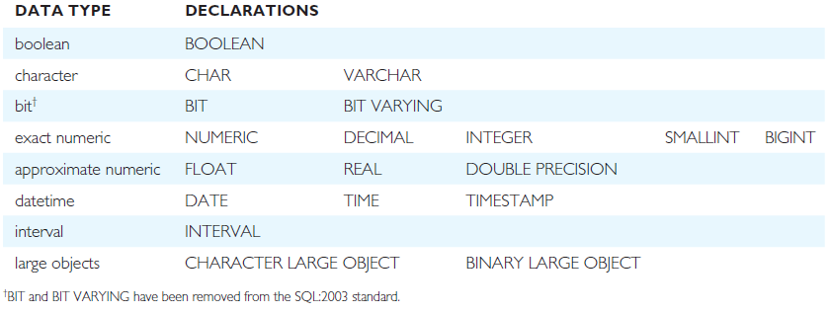
ISO SQL Data Types
^{CHAR: fixed length character}
VARCHAR: varying length character
^{NUMERIC[precision,[scale]]}
^{DECIMAL[precision,[scale]]}
^{The default scale is 0}
DECIMAL(6,2): can handle value up to 9,999.99

Slide 16
Integrity Enhancement Feature
Consider five types of integrity constraints:
required data (mandatory): attribute that must have a value (NOT NULL)
domain constraints: possible values for one/many attribute/s
entity integrity: Primary Key can’t have NULL value (NOT NULL) and must be unique
referential integrity: Foreign key has two types of possible values (1) NULL (if it is not mandatory) and (2) referred Primary Key values
general constraints: Enterprise Rules

Slide 17
Required Data
Required Data: Mandatory (the attribute must be filled with a value->NOT NULL)
CREATE TABLE STAFF
(
…
position VARCHAR(10) NOT NULL,
…
)

Slide 18
Domain Constraints
Domain Constraints
CHECK (Only used in one particular table)
Column Level
CREATE TABLE STAFF (
…
sex CHAR NOT NULL
CHECK (sex IN (‘M’, ‘F’)),
… )
Or
CREATE TABLE STAFF (
…
sex CHAR NOT NULL
CONSTRAINT C1 CHECK (sex IN (‘M’, ‘F’)),
… )

Slide 19
Domain Constraints
Domain Constraints
CHECK (Only used in one particular table)
Table Level
CREATE TABLE STAFF (
…
sex CHAR NOT NULL,
…
CHECK (sex IN (‘M’, ‘F’)),
… )
Or
CREATE TABLE STAFF (
…
sex CHAR NOT NULL,
…
CONSTRAINT C1 CHECK (sex IN (‘M’, ‘F’)),
… )

Slide 20
Domain Constraints
(b) CREATE DOMAIN (can be used in more than one table)
CREATE DOMAIN DomainName [AS] dataType
[DEFAULT defaultOption]
[CHECK (searchCondition)]
For example:
CREATE DOMAIN SexType AS CHAR
CHECK (VALUE IN (‘M’, ‘F’));
CREATE TABLE STAFF (
…
sex SexType NOT NULL,
… )

Slide 21
Domain Constraints
searchCondition can involve a table lookup:
CREATE DOMAIN BranchNo AS CHAR(4)
CHECK (VALUE IN (SELECT branchNo
FROM Branch));
Domains can be removed using DROP DOMAIN:
DROP DOMAIN DomainName
[RESTRICT | CASCADE]

Slide 22
IEF - Entity Integrity
Primary key of a table must contain a unique, non-null value for each row.
ISO standard supports PRIMARY KEY clause in CREATE and ALTER TABLE statements:
CREATE TABLE STAFF (
…
staffNo VARCHAR(5) PRIMARY KEY,
… )
Or
CREATE TABLE STAFF (
staffNo VARCHAR(5) NOT NULL,
…
PRIMARY KEY(staffNo),
… )

Slide 23
IEF - Entity Integrity
ISO standard supports PRIMARY KEY clause in CREATE and ALTER TABLE statements:
CREATE TABLE VIEWING (
clientNo VARCHAR(5) NOT NULL,
propertyNo VARCHAR(5) NOT NULL,
…
PRIMARY KEY(clientNo, propertyNo),
… )
Can only have one PRIMARY KEY clause per table. Can still ensure uniqueness for alternate keys using UNIQUE:
CREATE TABLE CLIENT (
…
UNIQUE(telNo),
… )

Slide 24
IEF - Referential Integrity
FK is column or set of columns that links each row in child table containing foreign FK to row of parent table containing matching PK.
Referential integrity means that, if FK contains a value, that value must refer to existing row in parent table.
ISO standard supports definition of FKs with FOREIGN KEY clause in CREATE and ALTER TABLE:
CREATE TABLE STAFF ( …
branchNo CHAR(4) REFERENCES Branch,
… )
Or
CREATE TABLE STAFF ( …
branchNo CHAR(4), …
FOREIGN KEY(branchNo) REFERENCES Branch
)

Slide 25
IEF - Referential Integrity
Any INSERT/UPDATE attempting to create FK value in child table without matching CK value in parent is rejected.
Action taken attempting to update/delete a CK value in parent table with matching rows in child is dependent on referential action specified using ON UPDATE and ON DELETE subclauses. For example referential action using ON DELETE :
CASCADE: Delete row from parent and delete matching rows in child, and so on in cascading manner.
SET NULL: Delete row from parent and set FK column(s) in child to NULL. Only valid if FK columns are NOT NULL (not mandatory).
SET DEFAULT: Delete row from parent and set each component of FK in child to specified default. Only valid if DEFAULT specified for FK columns.
NO ACTION: Reject delete from parent. Default.

Slide 26
IEF - Referential Integrity
ON UPDATE CASCADE:
Branch Staff
branchNo: B001 All Staff records with branchNo: B001
is updated into B011 are also updated into B011
ON UPDATE SET NULL:
Branch Staff
branchNo : B001 All Staff records with branchNo: B001
is updated into B011 are set to NULL value
ON DELETE CASCADE:
Branch Staff
branchNo : B001 All Staff records with branchNo: B001
This record is deleted are also deleted
ON DELETE SET NULL:
Branch Staff
branchNo : B001 All Staff records with branchNo: B001
This record is deleted are set to NULL value

Slide 27
IEF - Referential Integrity
FOREIGN KEY (staffNo) REFERENCES Staff ON DELETE SET NULL
FOREIGN KEY (ownerNo) REFERENCES Owner ON UPDATE CASCADE

Slide 28
IEF - General Constraints
Could use CHECK/UNIQUE in CREATE and ALTER TABLE.
Similar to the CHECK clause, also have:
CREATE ASSERTION AssertionName
CHECK (searchCondition)

Slide 29
IEF - General Constraints
CREATE ASSERTION StaffNotHandlingTooMuch
CHECK (NOT EXISTS (SELECT staffNo
FROM PropertyForRent
GROUP BY staffNo
HAVING COUNT(*) > 100))

Slide 30
Data Definition
SQL DDL allows database objects such as schemas, domains, tables, views, and indexes to be created and destroyed.
Main SQL DDL statements are:
CREATE SCHEMA DROP SCHEMA
CREATE/ALTER DOMAIN DROP DOMAIN
CREATE/ALTER TABLE DROP TABLE
CREATE VIEW DROP VIEW
Many DBMSs also provide:
CREATE INDEX DROP INDEX
CREATE INDEX Index_name ON Table_Name(Column1 [,column2,..])

Slide 31
Data Definition
Relations and other database objects exist in an environment.
Each environment contains one or more catalogs, and each catalog consists of set of schemas.
Schema is named collection of related database objects.
Objects in a schema can be tables, views, domains, assertions, collations, translations, and character sets. All have same owner.

Slide 32
CREATE SCHEMA
CREATE SCHEMA [Name |
AUTHORIZATION CreatorId ]
DROP SCHEMA Name [RESTRICT | CASCADE ]
With RESTRICT (default), schema must be empty or operation fails.
With CASCADE, operation cascades to drop all objects associated with schema in order defined above. If any of these operations fail, DROP SCHEMA fails.

Slide 33
CREATE TABLE
CREATE TABLE TableName
{(colName dataType [NOT NULL] [UNIQUE]
[DEFAULT defaultOption]
[CHECK searchCondition] [,...]}
[PRIMARY KEY (listOfColumns),]
{[UNIQUE (listOfColumns),] […,]}
{[FOREIGN KEY (listOfFKColumns)
REFERENCES ParentTableName [(listOfCKColumns)],
[ON UPDATE referentialAction]
[ON DELETE referentialAction ]] [,…]}
{[CHECK (searchCondition)] [,…] })

Slide 34

CREATE TABLE
Creates a table with one or more columns of the specified dataType.
With NOT NULL, system rejects any attempt to insert a null in the column.
Can specify a DEFAULT value for the column.
Primary keys should always be specified as NOT NULL.
FOREIGN KEY clause specifies FK along with the referential action.
www.zentut.com

Slide 35
Example 7.1 - CREATE TABLE
CREATE DOMAIN OwnerNumber AS VARCHAR(5)
CHECK (VALUE IN (SELECT ownerNo FROM PrivateOwner));
CREATE DOMAIN StaffNumber AS VARCHAR(5)
CHECK (VALUE IN (SELECT staffNo FROM Staff));
CREATE DOMAIN BranchNumber AS CHAR(4)
CHECK (VALUE IN (SELECT branchNo FROM Branch));
CREATE DOMAIN PropertyNumber AS VARCHAR(5);
CREATE DOMAIN DStreet AS VARCHAR(25);
CREATE DOMAIN DCity AS VARCHAR(15);
CREATE DOMAIN DPostCode AS VARCHAR(8);

Slide 36
Example 7.1 - CREATE TABLE
CREATE DOMAIN PropertyType AS CHAR(1)
CHECK(VALUE IN (‘B’,’C’,’D’,’E’,’F’,’M’,’S’));
CREATE DOMAIN PropertyRooms AS SMALLINT
CHECK(VALUE BETWEEN 1 AND 15);
CREATE DOMAIN PropertyRent AS DECIMAL(6,2)
CHECK(VALUE BETWEEN 0 AND 9999.99);

Slide 37
Example 7.1 - CREATE TABLE
CREATE TABLE PropertyForRent (
propertyNo PropertyNumber NOT NULL,
street DStreet NOT NULL,
city DCity NOT NULL,
postcode DPostCode,
type PropertyType NOT NULL DEFAULT ‘F’,
rooms PropertyRooms NOT NULL DEFAULT 4,
rent PropertyRent NOT NULL DEFAULT 600,
ownerNo OwnerNumber NOT NULL,
...

Slide 38
Example 7.1 - CREATE TABLE
…
staffNo StaffNumber
Constraint StaffNotHandlingTooMuch
CHECK (NOT EXISTS (SELECT staffNo
FROM PropertyForRent
GROUP BY staffNo
HAVING COUNT(*) > 100)),
branchNo BranchNumber NOT NULL,
PRIMARY KEY (propertyNo),
FOREIGN KEY (staffNo) REFERENCES Staff
ON DELETE SET NULL ON UPDATE CASCADE,
FOREIGN KEY (ownerNo) REFERENCES PrivateOwner
ON DELETE NO ACTION ON UPDATE CASCADE,
FOREIGN KEY (branchNo) REFERENCES Branch
ON DELETE NO ACTION ON UPDATE CASCADE
);

Slide 39

ALTER TABLE
Add a new column to a table.
Drop a column from a table.
Add a new table constraint.
Drop a table constraint.
Set a default for a column.
Drop a default for a column.
http://www.zentut.com/sql-tutorial/sql-alter-table/

Slide 40
Example 7.2(a) - ALTER TABLE
Change Staff table by removing default of ‘Assistant’ for position column and setting default for sex column to female (‘F’).
ALTER TABLE Staff
ALTER position DROP DEFAULT;
ALTER TABLE Staff
ALTER sex SET DEFAULT ‘F’;

Slide 41
Example 7.2(b) - ALTER TABLE
Remove constraint from PropertyForRent that staff are not allowed to handle more than 100 properties at a time.
ALTER TABLE PropertyForRent
DROP CONSTRAINT StaffNotHandlingTooMuch;
Add new column to Client table.
ALTER TABLE Client
ADD prefNoRooms PropertyRooms;

Slide 42
DROP TABLE
DROP TABLE TableName [RESTRICT | CASCADE]
e.g. DROP TABLE PropertyForRent;
Removes named table and all rows within it.
With RESTRICT, if any other objects depend for their existence on continued existence of this table, SQL does not allow request.
With CASCADE, SQL drops all dependent objects (and objects dependent on these objects).

Slide 43
Access Control - Authorization Identifiers and Ownership
Authorization identifier is normal SQL identifier used to establish identity of a user. Usually has an associated password.
Used to determine which objects user may reference and what operations may be performed on those objects.
Each object created in SQL has an owner, as defined in AUTHORIZATION clause of schema to which object belongs.
Owner is only person who may know about it.

Slide 44
Privileges
Actions user permitted to carry out on given base table or view:
SELECT Retrieve data from a table.
INSERT Insert new rows into a table.
UPDATE Modify rows of data in a table.
DELETE Delete rows of data from a table.
REFERENCES Reference columns of named table in integrity constraints.
USAGE Use domains, collations, character sets, and translations.

Slide 45
Privileges
Can restrict INSERT/UPDATE/REFERENCES to named columns.
Owner of table must grant other users the necessary privileges using GRANT statement.
To create view, user must have SELECT privilege on all tables that make up view and REFERENCES privilege on the named columns.

Slide 46
GRANT
GRANT {PrivilegeList | ALL PRIVILEGES}
^{ON ObjectName}
TO {AuthorizationIdList | PUBLIC}
^{[WITH GRANT OPTION]}
PrivilegeList consists of one or more of above privileges separated by commas.
ALL PRIVILEGES grants all privileges to a user.
PUBLIC allows access to be granted to all present and future authorized users.
ObjectName can be a base table, view, domain, character set, collation or translation.
WITH GRANT OPTION allows privileges to be passed on.

Slide 47
GRANT Examples
Give Manager full privileges to Staff table.
^{GRANT ALL PRIVILEGES}
^{ON Staff}
^{TO Manager WITH GRANT OPTION;}
Give users Personnel and Director SELECT and UPDATE on column salary of Staff.
^{GRANT SELECT, UPDATE (salary)}
^{ON Staff}
^{TO Personnel, Director;}
Give all users SELECT on Branch table.
^{GRANT SELECT}
^{ON Branch}
^{TO PUBLIC;}

Slide 48
REVOKE
REVOKE takes away privileges granted with GRANT.
^{REVOKE [GRANT OPTION FOR]}
{PrivilegeList | ALL PRIVILEGES}
^{ON ObjectName}
FROM {AuthorizationIdList | PUBLIC}
^{[RESTRICT | CASCADE]}
ALL PRIVILEGES refers to all privileges granted to a user by user revoking privileges.

Slide 49
REVOKE
GRANT OPTION FOR allows privileges passed on via WITH GRANT OPTION of GRANT to be revoked separately from the privileges themselves.
REVOKE fails if it results in an abandoned object, such as a view, unless the CASCADE keyword has been specified.
Privileges granted to this user by other users are not affected.

Slide 50
REVOKE Examples
Revoke privilege SELECT on Branch table from all users.
^{REVOKE SELECT}
^{ON Branch}
^{FROM PUBLIC;}
Revoke all privileges given to Director on Staff table.
^{REVOKE ALL PRIVILEGES}
^{ON Staff}
^{FROM Director;}

Slide 51
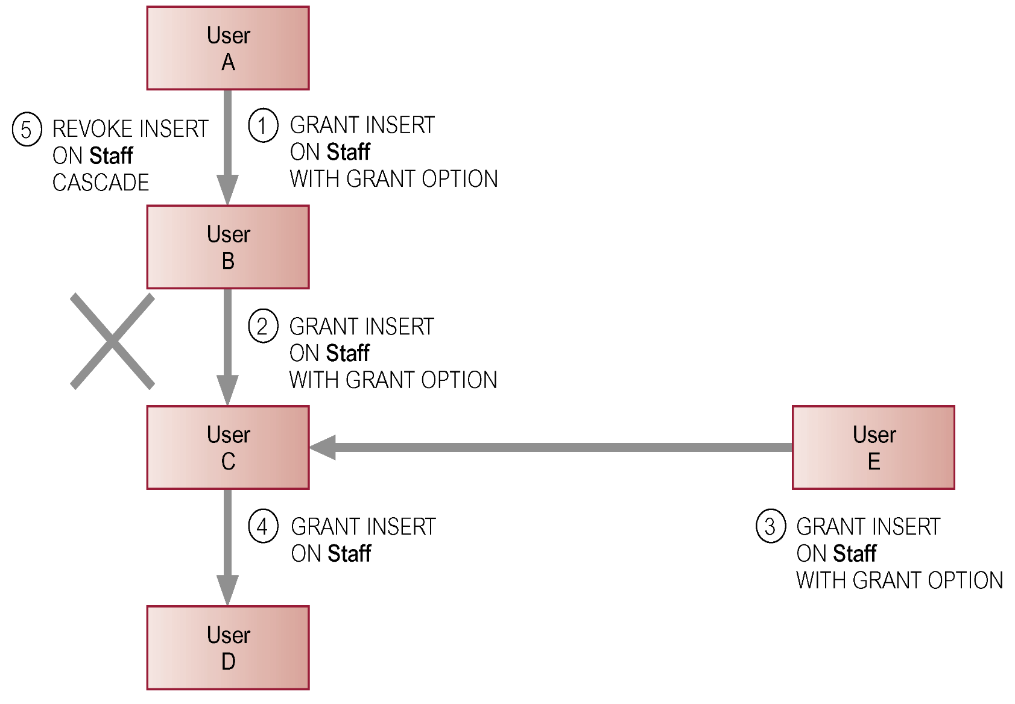
REVOKE

Slide 52
CHAPTER 6 SQL : DATA MANIPULATION

Slide 53
LEARNING OBJECTIVES-CHAPTER 6
How to retrieve data from database using SELECT and:
Use compound WHERE conditions.
Sort query results using ORDER BY.
Use aggregate functions.
Group data using GROUP BY and HAVING.
vtraining-msuhandi.blogspot.com

Slide 54
SIMPLE SQL COMMANDS

Slide 56
comment

Slide 57
SELECT Statement
SELECT [DISTINCT | ALL]
{* | [columnExpression [AS newName]] [,...] }
FROM TableName [alias] [, ...]
[WHERE condition]
[GROUP BY columnList] [HAVING condition]
[ORDER BY columnList]
Order of the clauses cannot be changed.
Only SELECT and FROM are mandatory.

Slide 58
SELECT Statement
SELECT Specifies which columns are to
appear in output.
FROM Specifies table(s) to be used.
WHERE Filters rows.
GROUP BY Forms groups of rows with same column value.
HAVING Filters groups subject to some
condition.
ORDER BY Specifies the order of the output.

Slide 59
SELECT Statement
Select SELECT { * | field_name [, …] } FROM table_name [, …]
Distinct SELECT DISTINCT { * | field_name [, …] } FROM table_name [, …]
Where SELECT { * | field_name [, …] } FROM table_name [, …] WHERE {condition}
Between SELECT { * | field_name [, …] } FROM table_name [, …] WHERE field_name BETWEEN value1AND value2
Like SELECT { * | field_name [, …] } FROM table_name [, …] WHERE field_name LIKE {PATTERN}

Slide 60
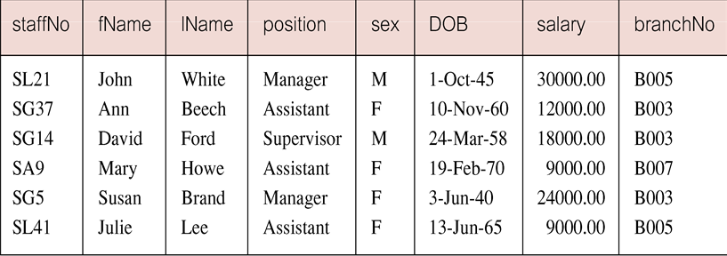
Example 6.1 All Columns, All Rows
List full details of all staff.
SELECT staffNo, fName, lName, address, position, sex,
DOB, salary, branchNo
FROM Staff;
Can use * as an abbreviation for ‘all columns’:
SELECT *
FROM Staff;

Slide 61
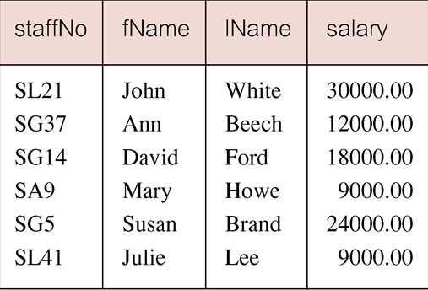
Example 6.2 Specific Columns, All Rows
Produce a list of salaries for all staff, showing only staff number, first and last names, and salary.
SELECT staffNo, fName, lName, salary
FROM Staff;

Slide 62
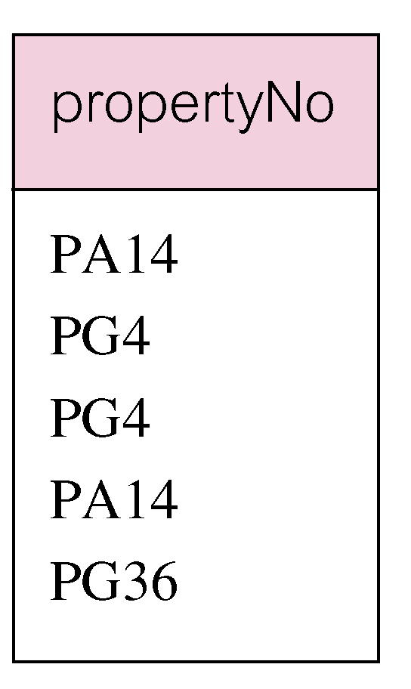
Example 6.3 Use of DISTINCT
List the property numbers of all properties that have been viewed.
SELECT propertyNo
FROM Viewing;

Slide 63
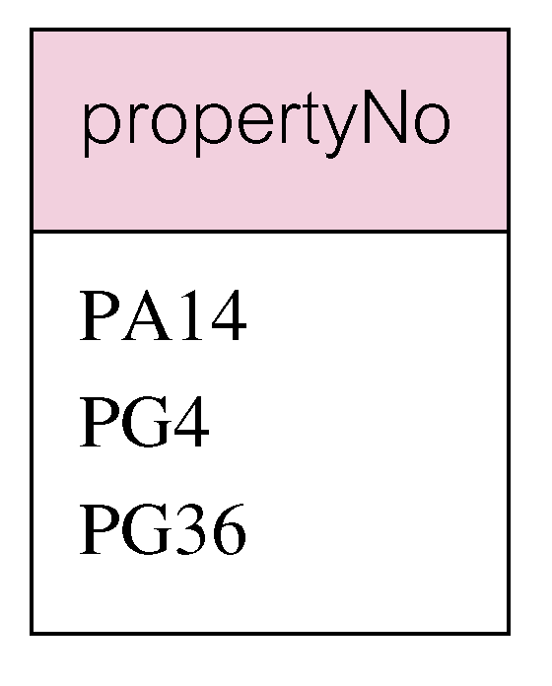
Example 6.3 Use of DISTINCT
Use DISTINCT to eliminate duplicates:
SELECT DISTINCT propertyNo
FROM Viewing;

Slide 64
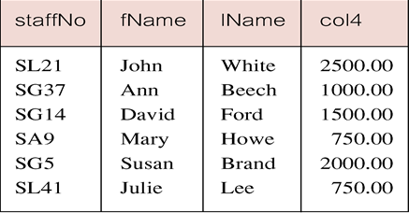
Example 6.4 Calculated Fields
Produce list of monthly salaries for all staff, showing staff number, first/last name, and salary.
SELECT staffNo, fName, lName, salary/12
FROM Staff;
To name column, use AS clause:
SELECT staffNo, fName, lName, salary/12
AS monthlySalary
FROM Staff;

Slide 65
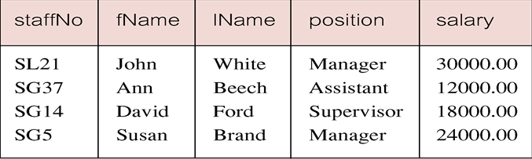
Example 6.5 Comparison Search Condition
List all staff with a salary greater than 10,000.
SELECT staffNo, fName, lName, position, salary
FROM Staff
WHERE salary > 10000;

Slide 66
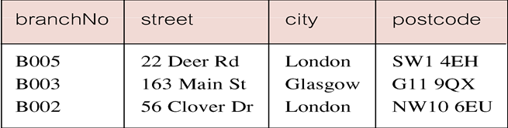
Example 6.6 Compound Comparison Search Condition
List addresses of all branch offices in London or Glasgow.
SELECT *
FROM Branch
WHERE city = ‘London’ OR city = ‘Glasgow’;

Slide 67
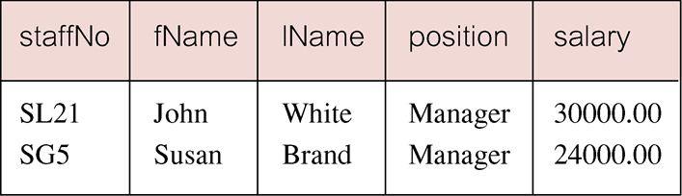
Example 6.7 Range Search Condition
List all staff with a salary between 20,000 and 30,000.
SELECT staffNo, fName, lName, position, salary
FROM Staff
WHERE salary BETWEEN 20000 AND 30000;
BETWEEN test includes the endpoints of range.

Slide 68
Example 6.7 Range Search Condition
Also a negated version NOT BETWEEN.
BETWEEN does not add much to SQL’s expressive power. Could also write:
SELECT staffNo, fName, lName, position, salary
FROM Staff
WHERE salary>=20000 AND salary <= 30000;
Useful, though, for a range of values.

Slide 69
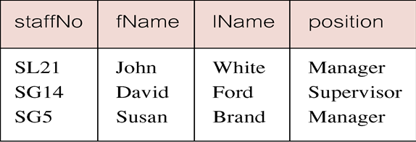
Example 6.8 Set Membership
List all managers and supervisors.
SELECT staffNo, fName, lName, position
FROM Staff
WHERE position IN (‘Manager’, ‘Supervisor’);

Slide 70
Example 6.8 Set Membership
There is a negated version (NOT IN).
IN does not add much to SQL’s expressive power. Could have expressed this as:
SELECT staffNo, fName, lName, position
FROM Staff
WHERE position=‘Manager’ OR
position=‘Supervisor’;
IN is more efficient when set contains many values.
Pearson Education © 2014
70

Slide 71
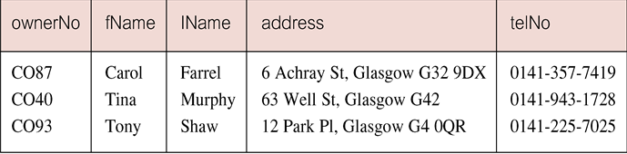
Example 6.9 Pattern Matching
Find all owners with the string ‘Glasgow’ in their address.
SELECT ownerNo, fName, lName, address, telNo
FROM PrivateOwner
WHERE address LIKE ‘%Glasgow%’;

Slide 72

Example 6.9 Pattern Matching
SQL has two special pattern matching symbols:
%: sequence of zero or more characters;
_ (underscore): any single character.
LIKE ‘%Glasgow%’ means a sequence of characters of any length containing ‘Glasgow’.
www.management-mentors.com

Slide 73
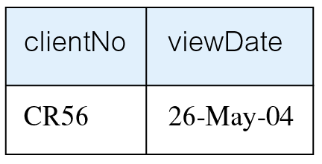
Example 6.10 NULL Search Condition
List details of all viewings on property PG4 where a comment has not been supplied.
There are 2 viewings for property PG4, one with and one without a comment.
Have to test for null explicitly using special keyword IS NULL:
SELECT clientNo, viewDate
FROM Viewing
WHERE propertyNo = ‘PG4’ AND
comment IS NULL;
Negated version (IS NOT NULL) can test for non-null values.

Slide 74
ORDER BY

Slide 75
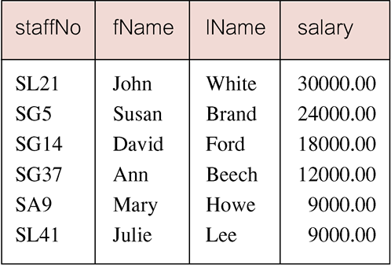
Example 6.11 Single Column Ordering
List salaries for all staff, arranged in descending order of salary.
SELECT staffNo, fName, lName, salary
FROM Staff
ORDER BY salary DESC;
ASC: Ascending
DESC: Descending
If not specified,
default: ascending

Slide 76
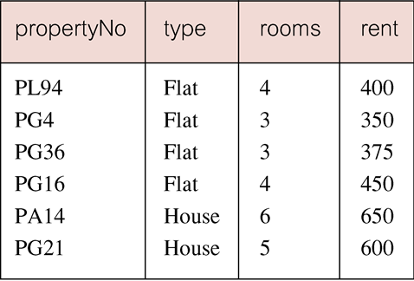
Example 6.12 Multiple Column Ordering
Produce abbreviated list of properties in order of property type.
SELECT propertyNo, type, rooms, rent
FROM PropertyForRent
ORDER BY type;

Slide 77
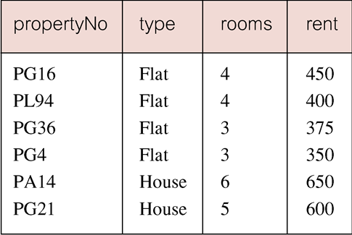
Example 6.12 Multiple Column Ordering
Four flats in this list - as no minor sort key specified, system arranges these rows in any order it chooses.
To arrange in order of rent, specify minor order:
SELECT propertyNo, type, rooms, rent
FROM PropertyForRent
ORDER BY type, rent DESC;

Slide 78
SQL Aggregate Functions

Slide 79
SELECT Statement - Aggregates
ISO standard defines five aggregate functions:
COUNT returns number of values in specified column.
SUM returns sum of values in specified column.
AVG returns average of values in specified column.
MIN returns smallest value in specified column.
MAX returns largest value in specified column.
COUNT
SUM
AVG
MIN
MAX

Slide 80
SELECT Statement - Aggregates
Each operates on a single column of a table and returns a single value.
COUNT, MIN, and MAX apply to numeric and non-numeric fields, but SUM and AVG may be used on numeric fields only.
Apart from COUNT(*), each function eliminates nulls first and operates only on remaining non-null values.
COUNT(*) counts all rows of a table, regardless of whether nulls or duplicate values occur.
Can use DISTINCT before column name to eliminate duplicates.
DISTINCT has no effect with MIN/MAX, but may have with SUM/AVG.

Slide 81
SELECT Statement - Aggregates
Aggregate functions can be used only in SELECT list and in HAVING clause.
If SELECT list includes an aggregate function and there is no GROUP BY clause, SELECT list cannot reference a column out with an aggregate function. For example, the following is illegal:
SELECT staffNo, COUNT(salary)
FROM Staff;

Slide 82
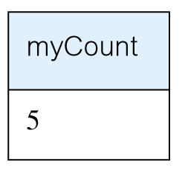
Example 6.13 Use of COUNT(*)
How many properties cost more than £350 per month to rent?
SELECT COUNT(*) AS myCount
FROM PropertyForRent
WHERE rent > 350;

Slide 83
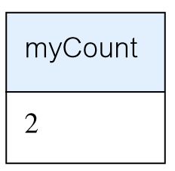
Example 6.14 Use of COUNT(DISTINCT)
How many different properties viewed in May ‘13?
SELECT COUNT(DISTINCT propertyNo) AS myCount
FROM Viewing
WHERE viewDate BETWEEN ‘1-May-13’
AND ‘31-May-13’;

Slide 84
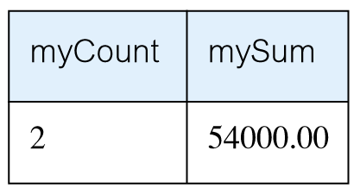
Example 6.15 Use of COUNT and SUM
Find number of Managers and sum of their salaries.
SELECT COUNT(staffNo) AS myCount,
SUM(salary) AS mySum
FROM Staff
WHERE position = ‘Manager’;

Slide 85
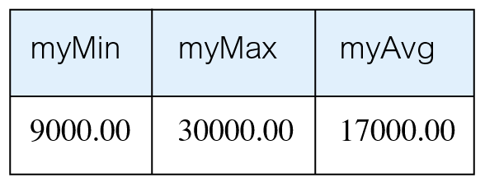
Example 6.16 Use of MIN, MAX, AVG
Find minimum, maximum, and average staff salary.
SELECT MIN(salary) AS myMin,
MAX(salary) AS myMax,
AVG(salary) AS myAvg
FROM Staff;

Slide 86
GROUP BY & HAVING

Slide 87
SELECT Statement - Grouping
Use GROUP BY clause to get sub-totals.
SELECT and GROUP BY closely integrated: each item in SELECT list must be single-valued per group, and SELECT clause may only contain:
column names
aggregate functions
constants
expression involving combinations of the above.

Slide 88
SELECT Statement - Grouping
All column names in SELECT list must appear in GROUP BY clause unless name is used only in an aggregate function.
If WHERE is used with GROUP BY, WHERE is applied first, then groups are formed from remaining rows satisfying predicate.
ISO considers two nulls to be equal for purposes of GROUP BY.

Slide 89
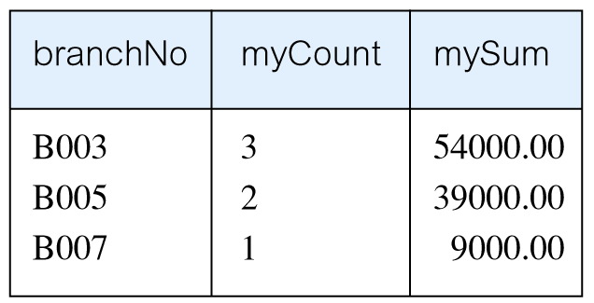
Example 6.17 Use of GROUP BY
Find number of staff in each branch and their total salaries.
SELECT branchNo,
COUNT(staffNo) AS myCount,
SUM(salary) AS mySum
FROM Staff
GROUP BY branchNo
ORDER BY branchNo;

Slide 90
Restricted Groupings – HAVING clause
HAVING clause is designed for use with GROUP BY to restrict groups that appear in final result table.
Similar to WHERE, but WHERE filters individual rows whereas HAVING filters groups.
Column names in HAVING clause must also appear in the GROUP BY list or be contained within an aggregate function.

Slide 91
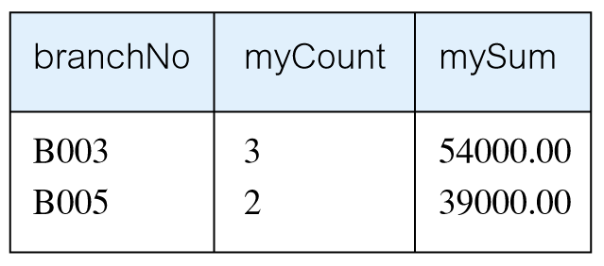
Example 6.18 Use of HAVING
For each branch with more than 1 member of staff, find number of staff in each branch and sum of their salaries.
SELECT branchNo,
COUNT(staffNo) AS myCount,
SUM(salary) AS mySum
FROM Staff
GROUP BY branchNo
HAVING COUNT(staffNo) > 1
ORDER BY branchNo;

Slide 92

www.healthytravelblog.com

